Slide 1
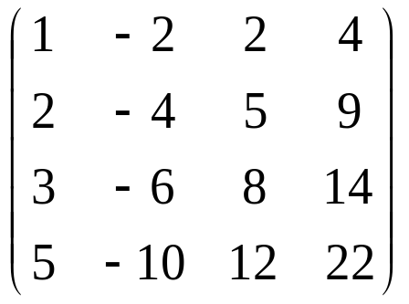
The linear transformation T: R⁴ → R⁴ is represented by the matrix
M =
.
(i) Find the rank of M.
(ii) Obtain a basis for the null space, K, of T.

Slide 2
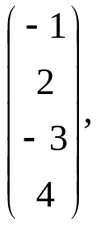
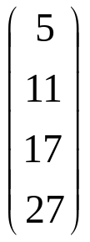
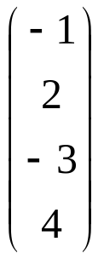
(iii) Evaluate
M
and hence show that any solution of
Mx =
(*)
has the form
+λe₁ + μe₂,
where λ and μ are constants and {e₁, e₂} is a basis for K.

Slide 3
(iv) Find the solution x₁ of (*) such that the first
component of x₁ is A, and the sum of all the
components of x₁ is B.

Slide 4
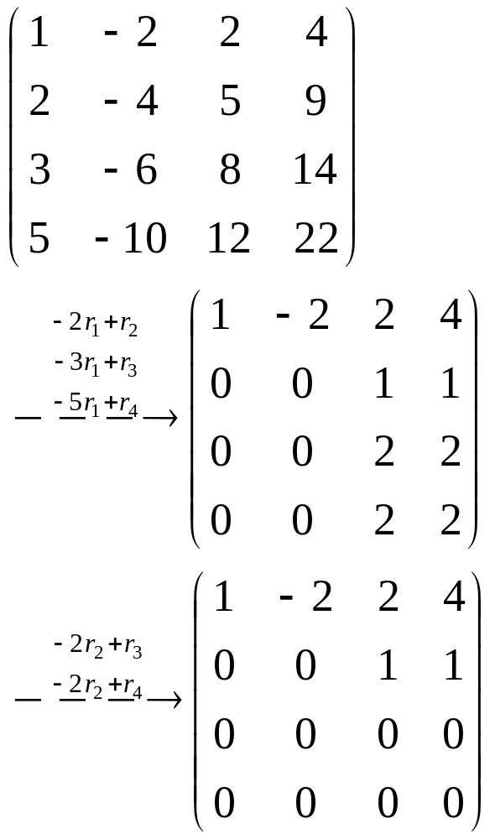
(i)
rank (M) = 2

Slide 5
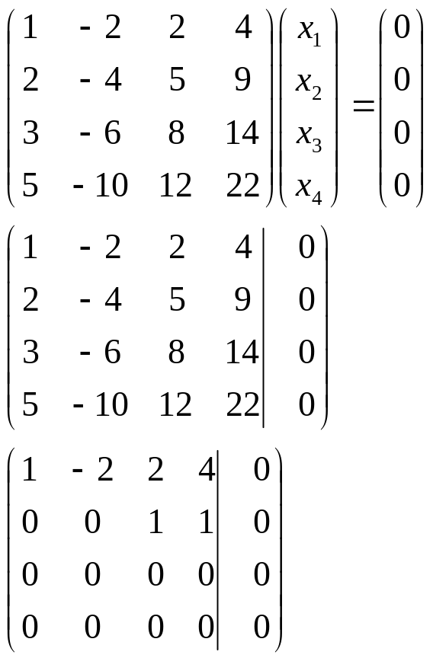
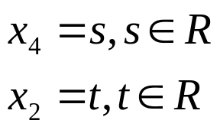
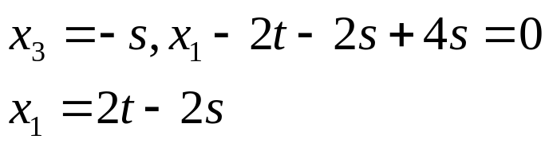
(ii)
Let
and

Slide 6
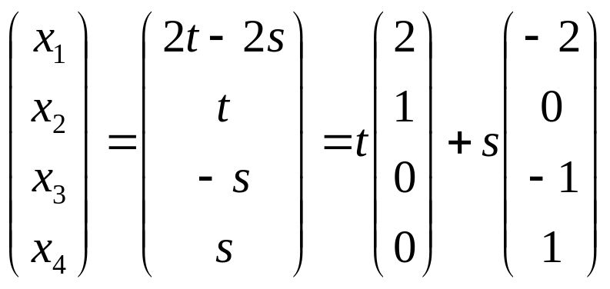
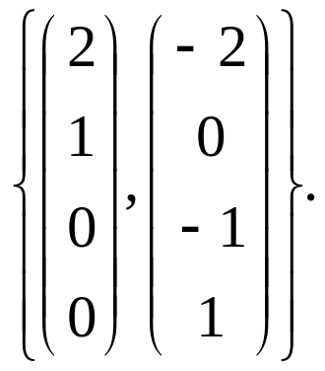
A basis for the null space, K, of T is

Slide 7
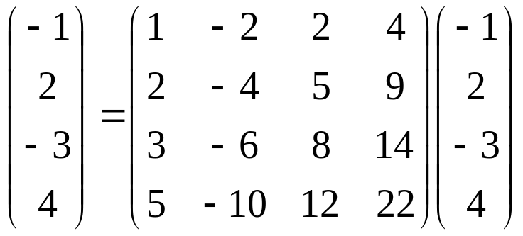
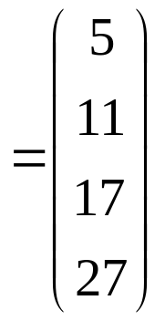
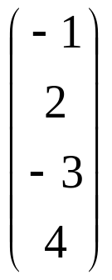
(iii) M
Since
is a solution of the equation

Slide 8
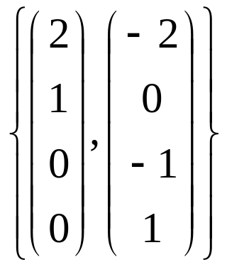
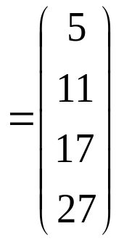
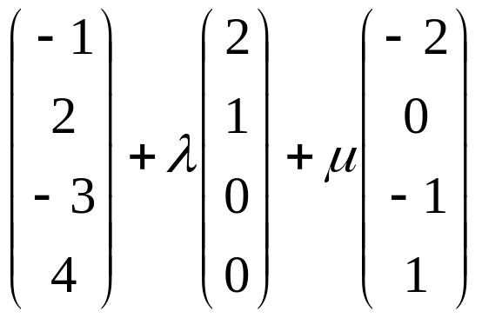
Mx
and
forms a basis for K,
any solution of (*) has the form
where λ and μ are constants.

Slide 9
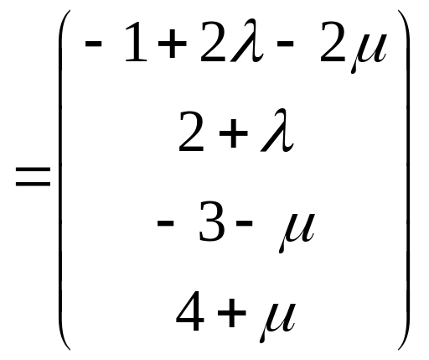
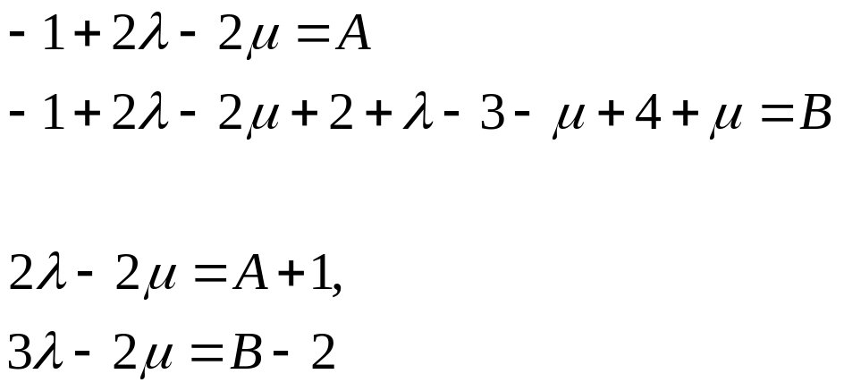
(iv) If x₁ =
and

Slide 10
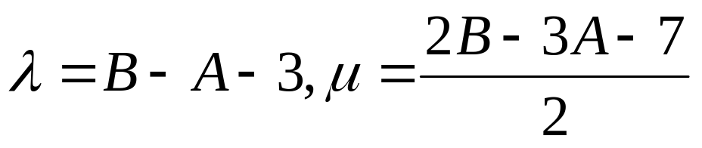
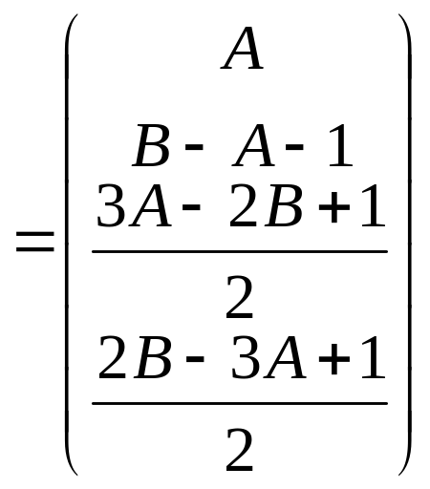
X₁

Slide 11
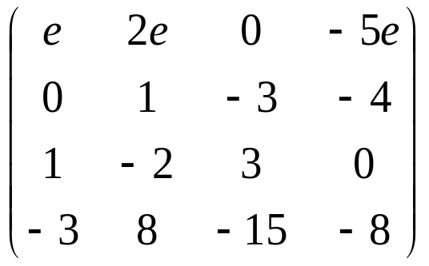
The linear transformation T: R⁴ → R⁴ is represented by the matrix
M =
, e is a constant.
The null space of T is denoted by K₁ when e ≠ 0 and by K₂ when e = 0.

Slide 12
i) Find a basis for K₁ and a basis for K₂.
ii) Verify that K₁ is a subspace of K₂.
iii) If the set V consists of the zero vector
together with the vectors in K₂ which are
not in K₁, determine whether V is a
vector space.

Slide 13
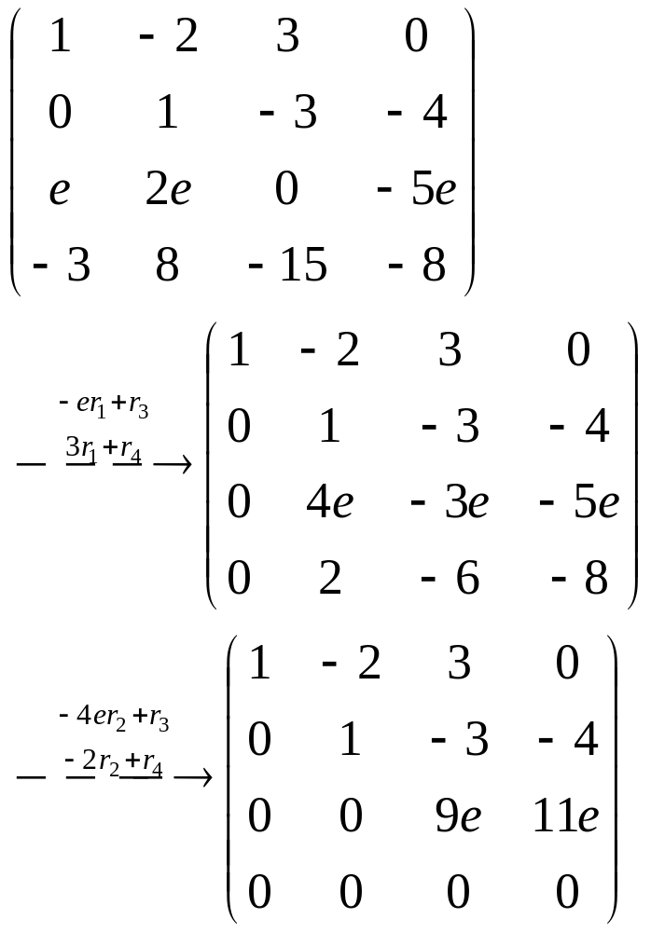

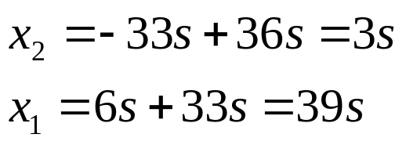
i)
If e ≠ 0
Let

Slide 14
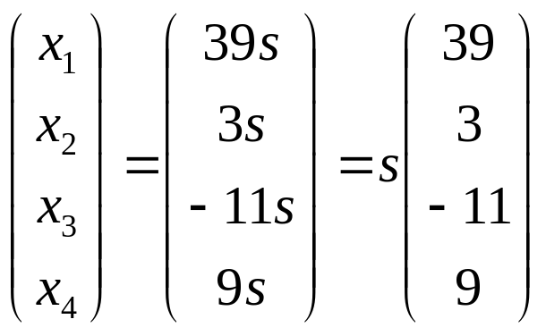
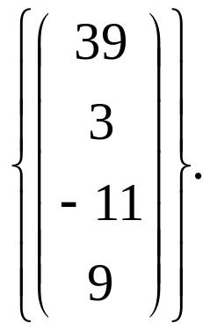
A basis for the null space, K₁, of T is

Slide 15
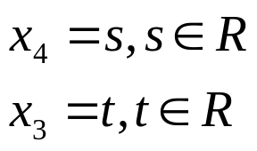
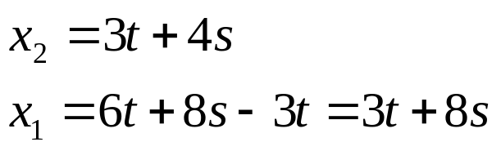
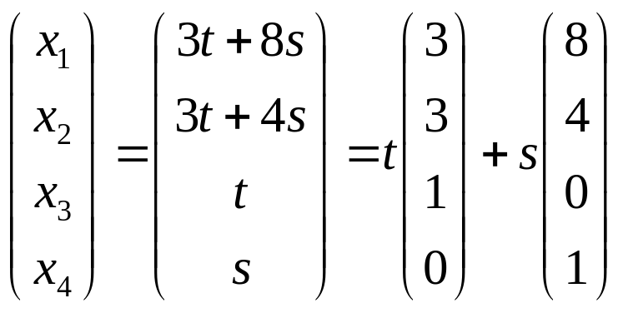
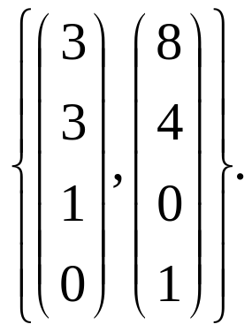
If e = 0 Let
A basis for the null space, K₂, of T is

Slide 16
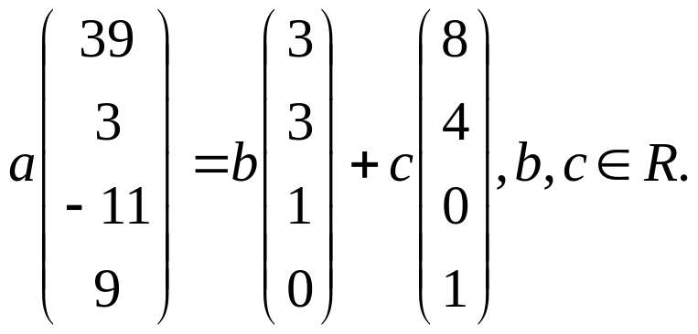
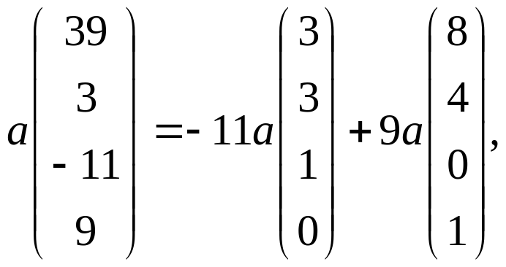


ii) If K₁ is a subspace of K₂ then
Since
K₁ is a subspace of K₂.

Slide 17
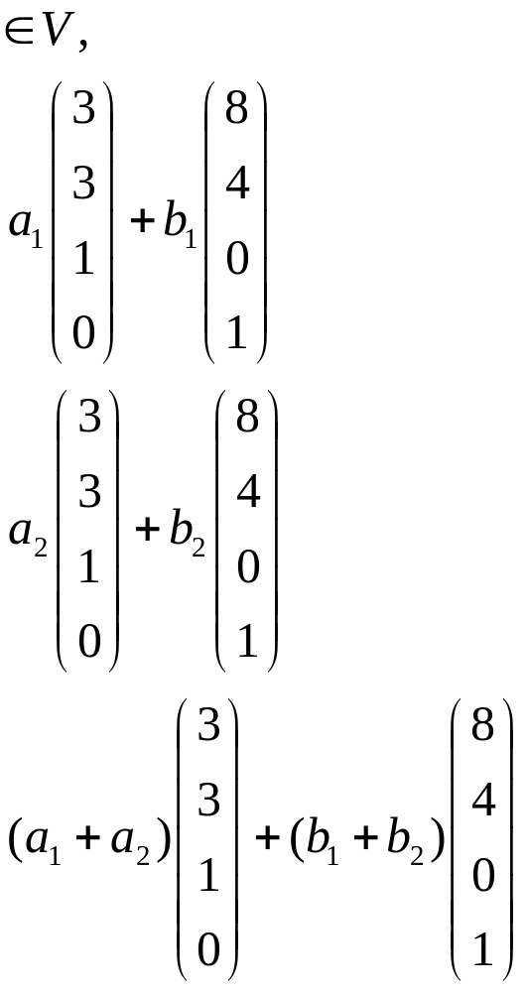

iii) If x, y
V = K₂ \ K₁, let
x =
y =
since x, y
x + y =

Slide 18
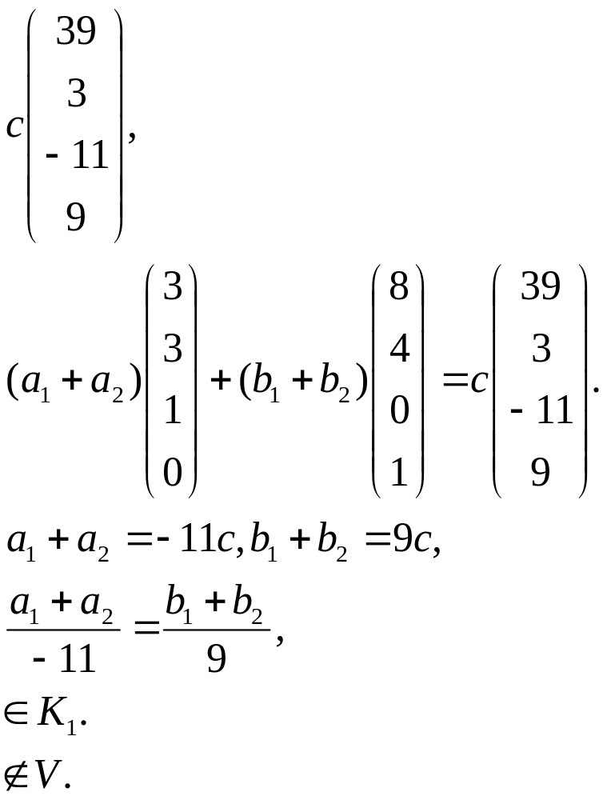

If x + y =
that is x + y
then
If
that is
x + y
x + y
V is not a vector space.

Slide 19
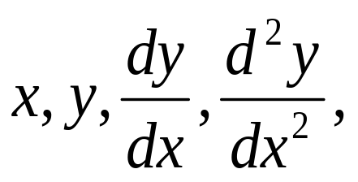
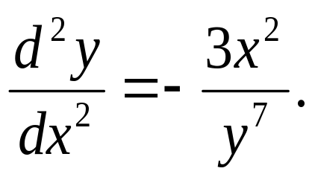
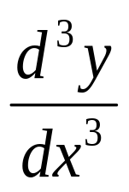
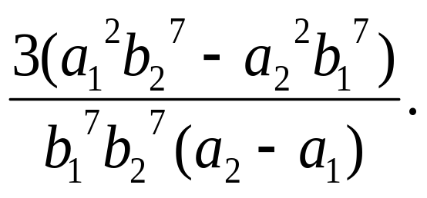
The variables x and y are related by the equation x⁴ + y⁴ = 1, where 0 < x < 1 and 0 < y < 1.
i) Obtain an equation which relates
and deduce that
ii) Given that y = b₁ and when x = a₁ and that y = b₂
when x = a₂, where a₁ < a₂, prove that the mean value
of
with respect to x over the interval a₁ ≤ x ≤ a₂ is

